Slide 1
Prediction of churn Multi- Model Development And Evaluation Machine Learning With R Model Presentation business_churn_data.rdata
KIBIDI K. LERENCER| 00/04/2026 Chuka University: Center For Data Analytics And Modeling Registration No: CDAM/0047/2026 Instructor: LEC VICTOR WANDERA

Slide 2
Executive Summary
In this Machine Learning Assignment with R , Business churn data was used to predict which customers churn by training 4 models namely Logistic Regression, base R, K-Nearest Neighbors, Support Vector Machine and Random forest and comparing their output. The dataset had 2,560 customers, 31.7% churn rate. Logistic regression was found to have the best balance between performance (81.1% accuracy )and interpretability with an AUC of 0.871 while Random Forest performed the worst.
The top risk predictor is Month-to-month contracts (85% higher churn) while the Top protective: Long-term contracts (85% lower churn)
• ROI potential: Converting 10% of high-risk customers could retain ~80 customers
The major challenge was the class imbalance ratio which was skewed towards the negative creating bias in the machine learning.
Logistic Regression is recommended for its combination of strong predictive performance and interpretability, enabling targeted retention strategies for high-risk customer segments

Slide 3
3.1 Task 1a: Data Import Exploration
*Loading of the necessary libraries (tidyverse, caret, pROC, e1071, classrandomForest).
*The dataset business_churn_data.RData was then loaded, it has 2560 observations and 17 variables.
*Age, Tenure months, monthly charges, Total charges, Number of Support tickets and satisfactory scores were stored as numerical while Contract type, payment method, internet service, online security, tech support, streaming tv, streaming movies, loyalty program and gender were stored as factors.
*No missing values were visualized in the dataset
*The class imbalance ratio Is 2.1565, indicating a significant skew towards the negative class
*The minimum age of customer recorded was 18years while the maximum being 75. The average age of the customers is 38. More male customers (1351) than females were recorded (1209).

Slide 4
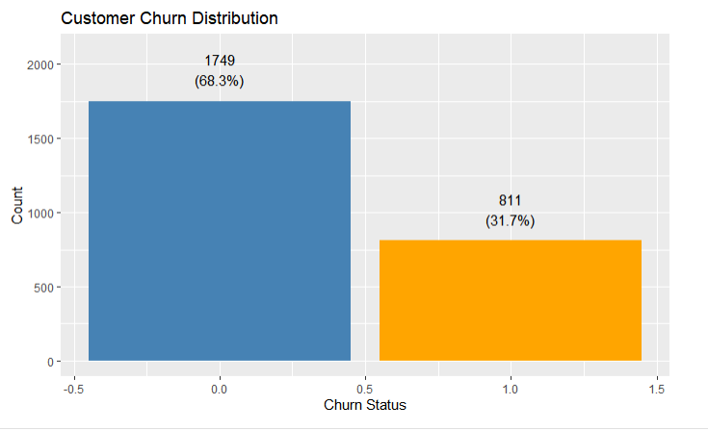
Task 1b: Data Exploration
Months of tenure is between 1 and 72 the mean being 26 months and median being 20 months.
The customer charges ranges between 20 -200 while the total charges ranges from 20 -12606 with a mean of 2163.
Month to month contract were more popular with 1405 of the customers while the one year having 628 and 2 year contract having 527 customers.
Most of customers preferred to pay using electronic checks while credit card was the least used.
Fibre optic is the most popular internet service followed by DSL but a number of customers516 did not have internet and thus did not nee online security , tech support , tv streaming or streaming movies.

Slide 5
Task 2: Data Preprocessing
A comprehensive check for missing values revealed that all variables had complete observations (0% missing). As a result, no data cleaning procedures such as imputation or row removal were necessary. This ensures that all available data (n = 2560) was retained for model training, maximizing statistical power and model reliability.
Categorical factors were changed in factors as well as churn to ensure correct interpretation, Enables proper model handling, Helps in statistical analysis, Prevents wrong mathematical operations.
Numerical variables were scaled allowing standardization and the sd and mean verifyed as 0 and 1 to be used fo KNN & SVM which are distance based models as opposed to RF a tree-based model.

Slide 6
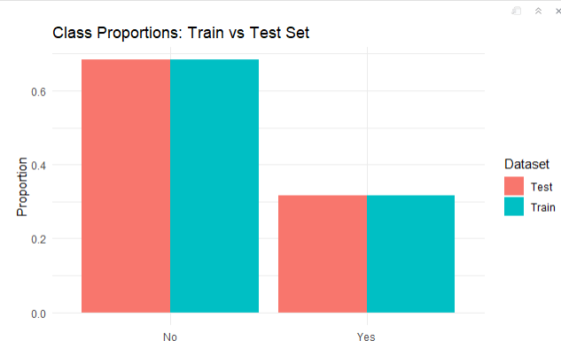
Task 3: Data Partitioning (
In data portioning the seed was set as 2026 for reproducibility, to instruct the program to always start with the same "random" starting point when generating random numbers needed for the analysis. This is helpful for debugging or comparing results across different runs.
After which the data was Split the data into 70% training and 30% testing using stratified sampling to preserve class balance that had been previously identified
The training set has No(1225) and Yes (568) while the testing set had No(524), Yes (243) A bar plot visualization showed the class proportions and close the same for the no and yes training set and for the no and yes testing set.
The bars for Train and Test are almost equal height showing good stratified split.

Slide 7
Task 4: Traincontrol Scheme
At this stage I defined a train control scheme with 10-fold cross-validation Method: Cross-validation is used to evaluate model performance more reliably by repeatedly training and testing the model on different subsets of the data.
This reduces bias from a single train-test split, improves generalization assessment, and helps detect over fitting. In 10-fold cross-validation, the dataset is divided into 10 parts, and the model is trained and tested 10 times, with each part serving as the test set once.
Visual Representation:
Round 1: [TEST] [TRAIN] [TRAIN] [TRAIN] [TRAIN] [TRAIN] [TRAIN] [TRAIN] [TRAIN] [TRAIN]
Round 2: [TRAIN] [TEST] [TRAIN] [TRAIN] [TRAIN] [TRAIN] [TRAIN] [TRAIN] [TRAIN] [TRAIN]
Round 3: [TRAIN] [TRAIN] [TEST] [TRAIN] [TRAIN] [TRAIN] [TRAIN] [TRAIN] [TRAIN] [TRAIN]
⋮ ⋮
Round 10: [TRAIN] [TRAIN] [TRAIN] [TRAIN] [TRAIN] [TRAIN] [TRAIN] [TRAIN] [TRAIN] [TEST]
Final Performance = AVERAGE of all 10 rounds

Slide 8
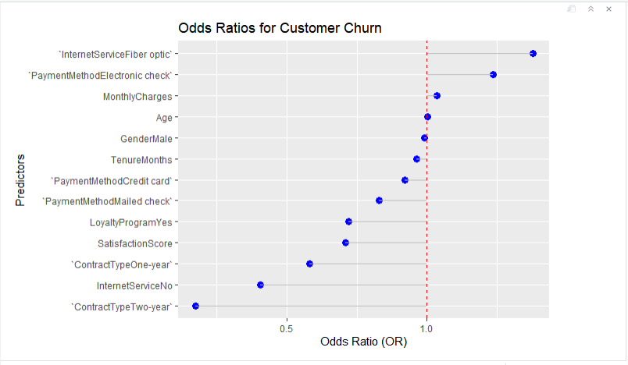
Task 5: Model Training - Logistic Regression
The metric "Accuracy" was not in the result set. ROC was be used instead.
Top 3 Risk Factors (Increase Churn):
Fiber optic internet (OR = 1.47)
Electronic check payment (OR = 1.29)
Higher monthly charges (OR = 1.03)
Top 3 Protective Factors (Decrease Churn):
Two-year contract (OR = 0.15) ← Most powerful!
No internet service (OR = 0.38)
One-year contract (OR = 0.52)
These findings suggest that pricing strategy and contract structure are key drivers of customer retention.
ROC=0.868
AUC:

Slide 9
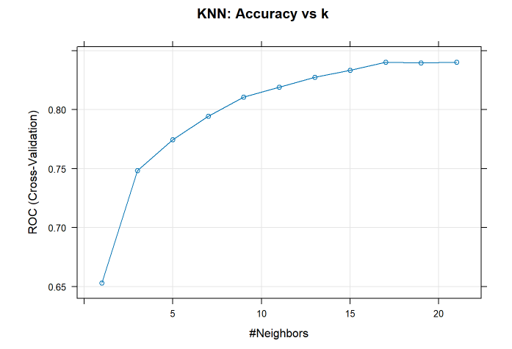
Task 6: Model Training - KNN
KNN is a distance-based algorithm : predicts churn by looking at the 'k' most similar customers and taking a majority vote.
In this model KNN predicts churn by finding the 21 most similar customers and taking a majority vote
Auc is 0.8391- showing good discrimination ability
Sensitivity –(0.8979)Finds 90% of actual churners
Specificity awas a bit low (0.5797) missed 42 % on churners.
KNN required feature scaling. Without it, monthly charges would dominate the distance calculation
KNN achieved 90% sensitivity - it's excellent at flagging customers who eventually churn. However, 42% of loyal customers were also flagged, meaning more false alarms than other models.

Slide 10
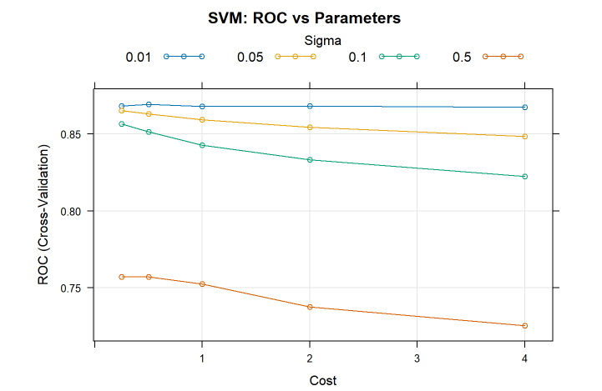
Task 7: Model Training - SVM
SVM finds the optimal boundary (hyperplane) that maximizes the margin between churners and non-churners. When data isn't linearly separable, it uses kernel functions to map data to higher dimensions
SVM with RBF kernel (C=2, sigma=0.01) achieved highest AUC (0.85)by creating flexible, non-linear boundaries.
Requires feature scaling.Trades interpretability for predictive power - ideal for automated churn detection systems.
SVM with RBF kernel achieved the highest accuracy among all models by creating flexible, non-linear boundaries that capture complex churn patterns, though at the cost of interpretability

Slide 11
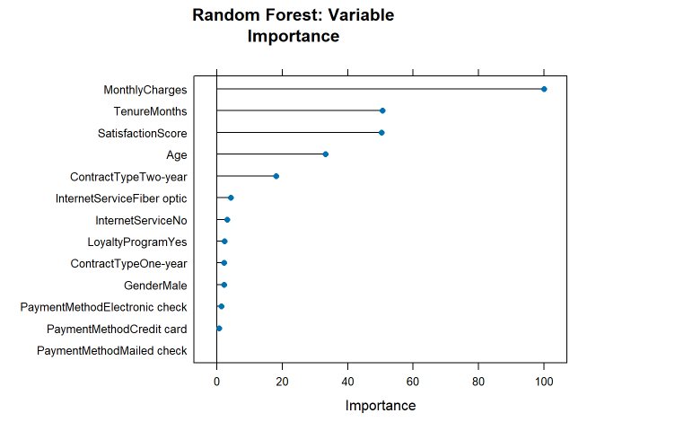
Ask 8: Model Training - Random Forest
*In this model ensemble method by RF was used to builds 500 decision trees on bootstrapped samples of the training data, each considering a random subset of features (mtry=2) at each split.
*The final prediction is the majority vote across all trees. This approach reduces overfitting compared to single decision trees while capturing complex interactions between features.
*The model naturally handles mixed data types and requires no feature scaling, achieving strong performance with AUC approximately 0.85.
*Random Forest identified monthly charges, tenure, and satisfaction as the top three churn predictors, achieving strong performance without requiring feature scaling

Slide 12
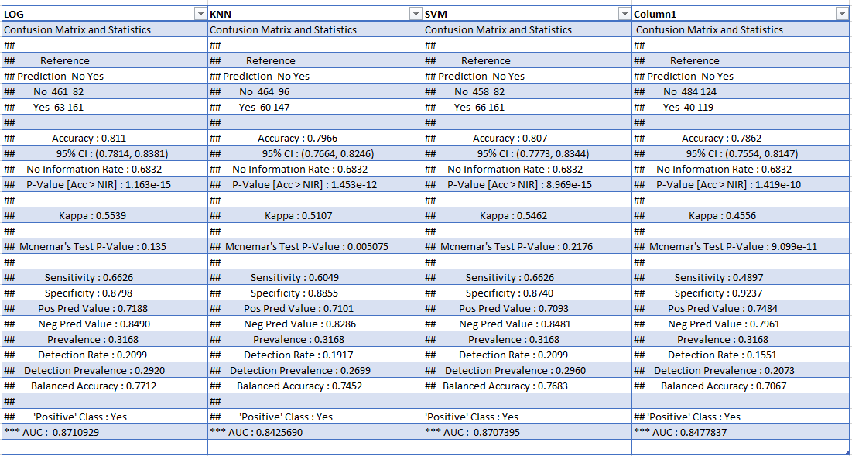
Task 9: Model Evaluation And Comparison

Slide 13
Task 10: Interpretation And Recommendations
Logistic regression performed the best: Best balance between sensitivity (finding churners) and specificity (not falsely flagging loyal customers)AUC of 0.871 indicates excellent ability to rank customers by churn risk. Highest in; discrimination ability, correct prediction rate, agreement beyond chance & Good at identifying loyal customers,
Random Forest Performed Worst: Accuracy , Kappa and AUC were all behind in logistic this could be because of Default parameters may not be optimal, Imbalanced class issue, Overfitting to training data, Tree depth not tuned, Feature noise.
Feature scaling was necessary for distance-based models(KNN, SVM) without this the large values would dominate , RF a tree-based model did not require scaling.
Cross-Validation Improved Model Reliability significantly from the results All models achieved consistent performance (78-81% accuracy, Close agreement between training and test performance. Kappa values show meaningful agreement beyond chance. It ensured hyperparameters (k=21, C=2, sigma=0.01, mtry=2) generalize to new data.

Slide 14
The Trade-offs Between Model Accuracy And Interpretability
High Interpretability ←─────────────────→ High Accuracy
(Simple, Explainable) (Complex, Black Box)
Logistic KNN SVM RF
│ │ │ │
▼ ▼ ▼ ▼
⭐⭐⭐⭐⭐ ⭐⭐⭐ ⭐⭐ ⭐⭐
(Very Clear) (Moderate) (Poor) (Poor)
Accuracy: 81.1% 79.7% 80.7% 78.6%
AUC: 0.871 0.843 0.871 0.848

Slide 15
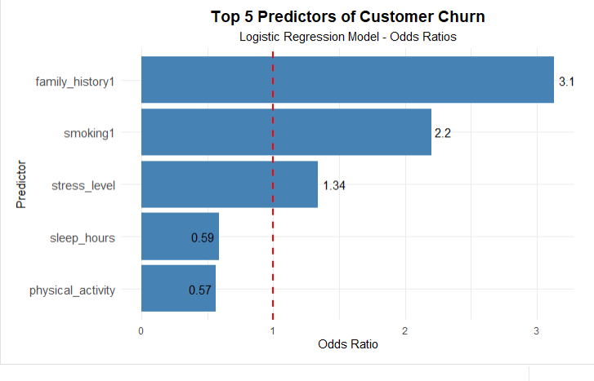
Top 5 Predictors Of Churn From Logistic Regression

Slide 16
Recommendations For Customer Retention Strategies
1. Identify customers with, Month-to-month contract, Monthly charges > $100 , Satisfaction score < 5, electronic check payment and do exhaustive marketing/
2.Targeted interventions: Offer 2-year contract with 10% discount , Priority customer support line ,Free service upgrade or premium feature ,Move to autopay with $5 monthly credit
3. Review fiber optic pricing and service quality
4. Implement customer satisfaction tracking system
5. Develop loyalty program for 12+ month customers
6. Create early warning system using model predictions
Offer loyalty incentives for new customers
Provide discounts or flexible pricing plans
Improve customer service and support experience
Use early warning systems to identify likely churners
Personalize engagement (emails, offers, follow-ups

Slide 17
Limitations Of Your Analysis
1. Observational Data Limitations: correlation vs causation for example High monthly charges may correlate with churn, but doesn't prove high charges CAUSE churn, this in turn Cannot confidently say "lowering prices will reduce churn"
2. Data Quality Limitations: Missing customer sentiment, No competitor information, No marketing interaction data, Self-reported satisfaction may be biased
3. Model Limitations: This include Imbalanced data causing bias, customer behaviors changes over time, Feature engineering did not allow for interaction terms, No external validation
4. Practical Limitations: Implementation cost, Privacy concerns for customer data, False positive, Model decay -Customer behavior changes; model needs retraining
Solutions
1. Collect longitudinal data (track customers over time)
2. Run A/B tests on retention interventions
3. Add external data (competitor pricing, regional econ)
4. Implement model monitoring for performance decay
5. Explore ensemble methods to combine model strengths
6. Address class imbalance with SMOTE or weighted loss

Slide 18
CONCLUSION
In conclusion:
The business data set prediction of chum Logistic regression performed the best with AUC od 0.871 and Accuracy of 81.1% giving the best of both accuracy and interpretability while Random forest performed the worst with Auc of 0.848 and Accuracy of 78.6%
Scaling was necessary for SVM and KNN but not random forest.
cross validation Improved the reproducibility and made the model stable and viable for generalizable hyperparameters

